Slide 1
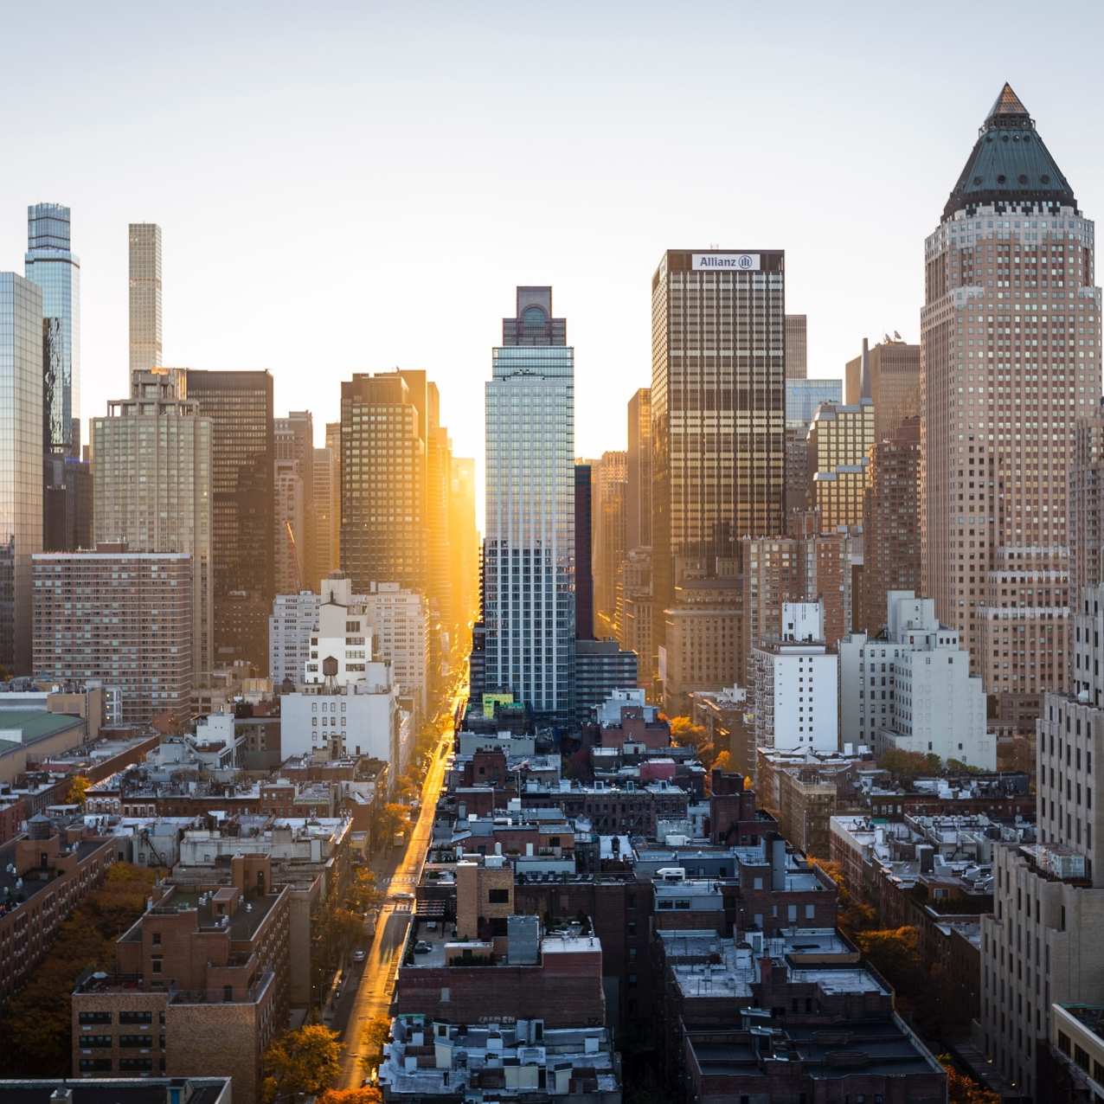
Developing a Sports Chatbot Language Model.
Mahnoor Maleeka (2020217)
Saad Khan (2020414)
Shaheer Asif (2020353)

Slide 2
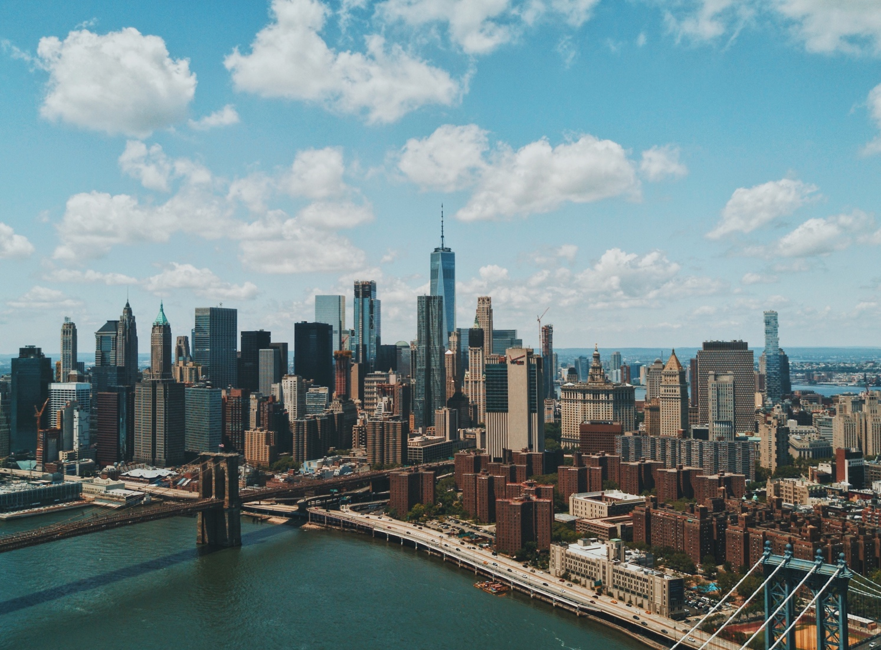
Introduction:
Sports enthusiasts often seek up-to date information, statistics, and engage in discussions related to their favorite sports. Developing a sports chatbot can enhance user experience by providing a personalized and interactive platform for sports-related conversations. This report presents the development of a sports chatbot using text-based generation techniques

Slide 3
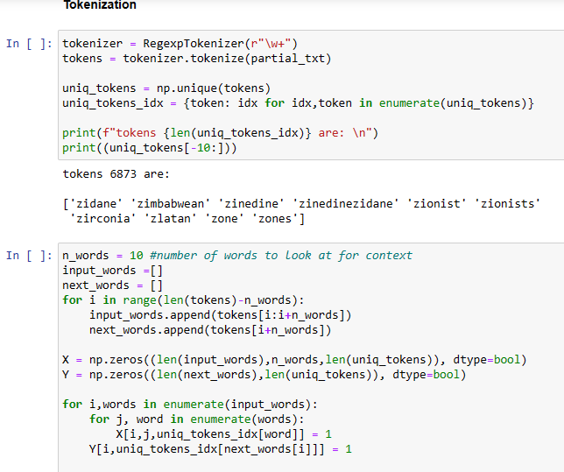
01 Data Collection Data Preprocessing Tokenization
The first step of our process was to gather relative sports data. The information was gathered from publicly available datasets on Kaggle. The data is basically scrapped from twitter.
Once the information is gathered, it should be preprocessed to guarantee consistency and work on the nature of the chatbot's reactions.
parting the information text into more modest units called tokens.

Slide 4
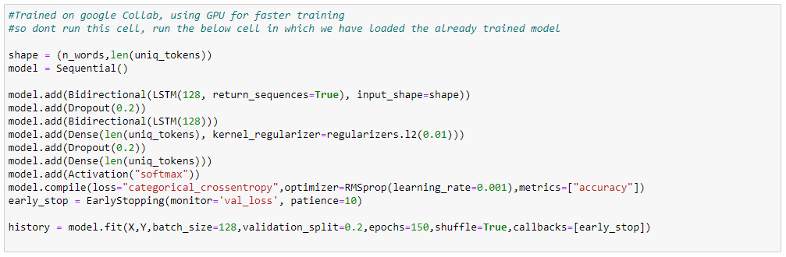
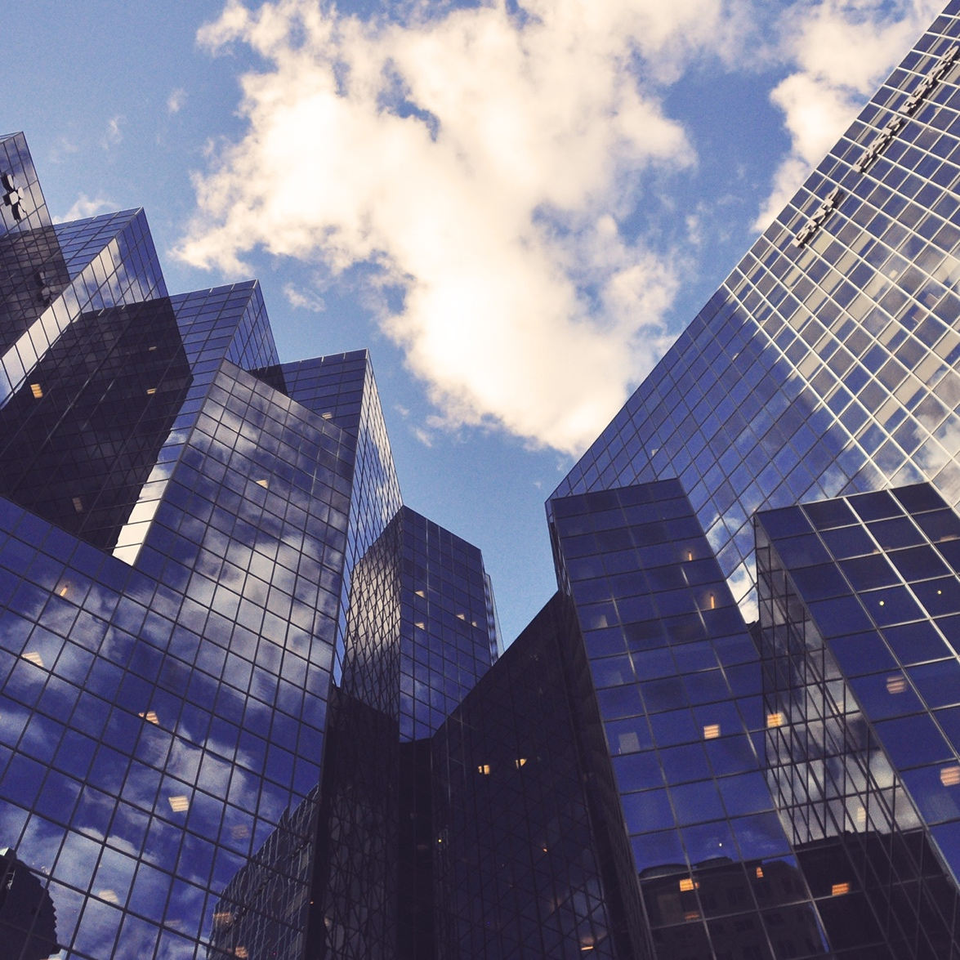
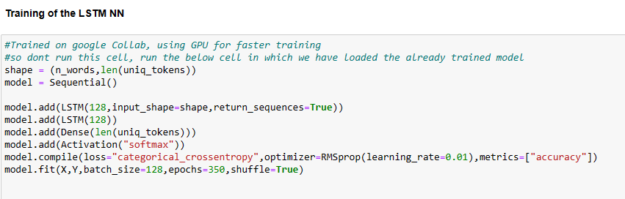
02 RNN LSTM BiLSTM
Recurrent Neural Networks are a class of artificial neural networks that can process sequential data. In the case of the sports chatbot, RNN is used to generate responses based on the context provided by the user.
LSTM is a type of RNN architecture that addresses the vanishing gradient problem and allows the network to retain long-term dependencies.
addresses the limitation of standard LSTMs by considering both past and future context when making predictions. Unlike traditional LSTMs that process sequential data in one direction, Bidirectional LSTMs process the input sequence in two directions: one forward pass and one backward pass.

Slide 5

03 sequence model training
The model is compiled with the categorical cross-entropy loss function, The optimizer used is RMSprop with a learning rate of 0.01, which is responsible for updating the model's weights during training. The training progress is monitored by the 'val_loss' metric, and early stopping is implemented with a patience of 10, meaning training will stop if the validation loss does not improve for 150 consecutive epochs.
A batch size of 128. A validation split of 0.2 is applied, meaning that 20% of the data is used for validation while the remaining 80% is used for training.
The 'shuffle' parameter ensuring that the training data is randomly shuffled before each epoch to avoid any bias in the order of the samples.

Slide 6
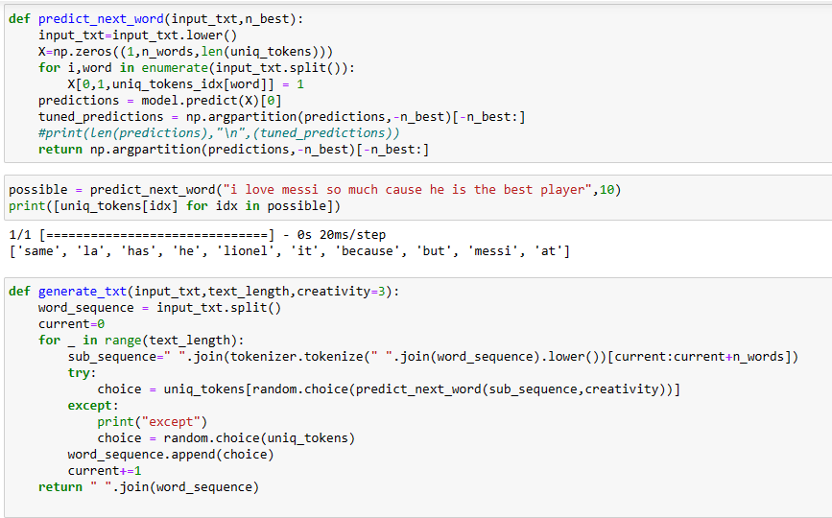
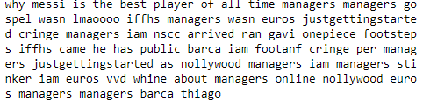
04 Next Word Prediction
takes the input text and the number of top predictions to return as parameters. The function converts the input text to lowercase and initializes an array to represent the input sequence. It then loops through the words in the input text, sets the corresponding position in the input array to 1, and uses the trained model to make predictions for the next word. The function returns the top predictions as a list of tokens. In the example provided, the function is used to predict the next word given any input text

Slide 7
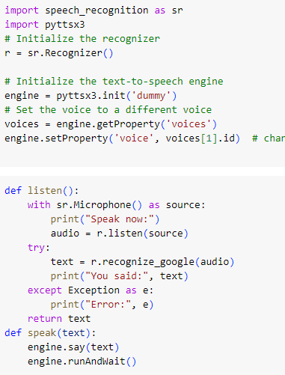
05 Text to speech Module
We also created a text to speech and a speech to text module. That will allow users to say anything to the chatbot and the chatbot will then answer back to the use using the speech module

Slide 8
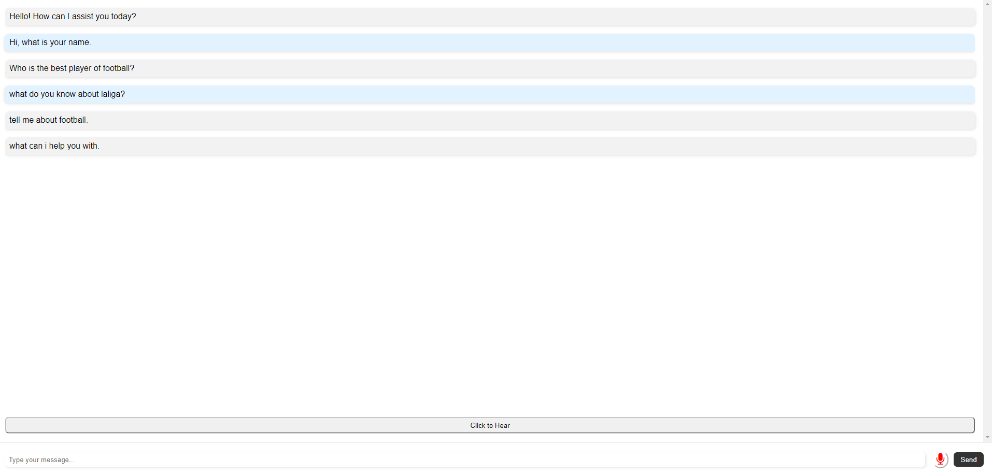
06 Website
To make the sports chatbot open to clients, it is incorporated into a site. The site gives an easy-to-understand interface where clients can communicate with the chatbot, ask sports-related inquiries, and get ongoing reactions. The incorporation should be possible utilizing web improvement innovations like HTML, CSS, and JavaScript

Slide 9
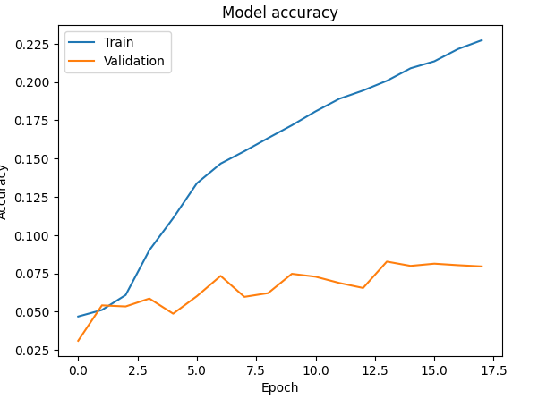
metrics

Slide 10

Thank you!

